Slide 1



Gender Pay Gap 2021-2024-r1
View in Power BI
Last data refresh:
15/01/2025 12:47:53 UTC
Downloaded at:
15/01/2025 12:51:17 UTC

Slide 2
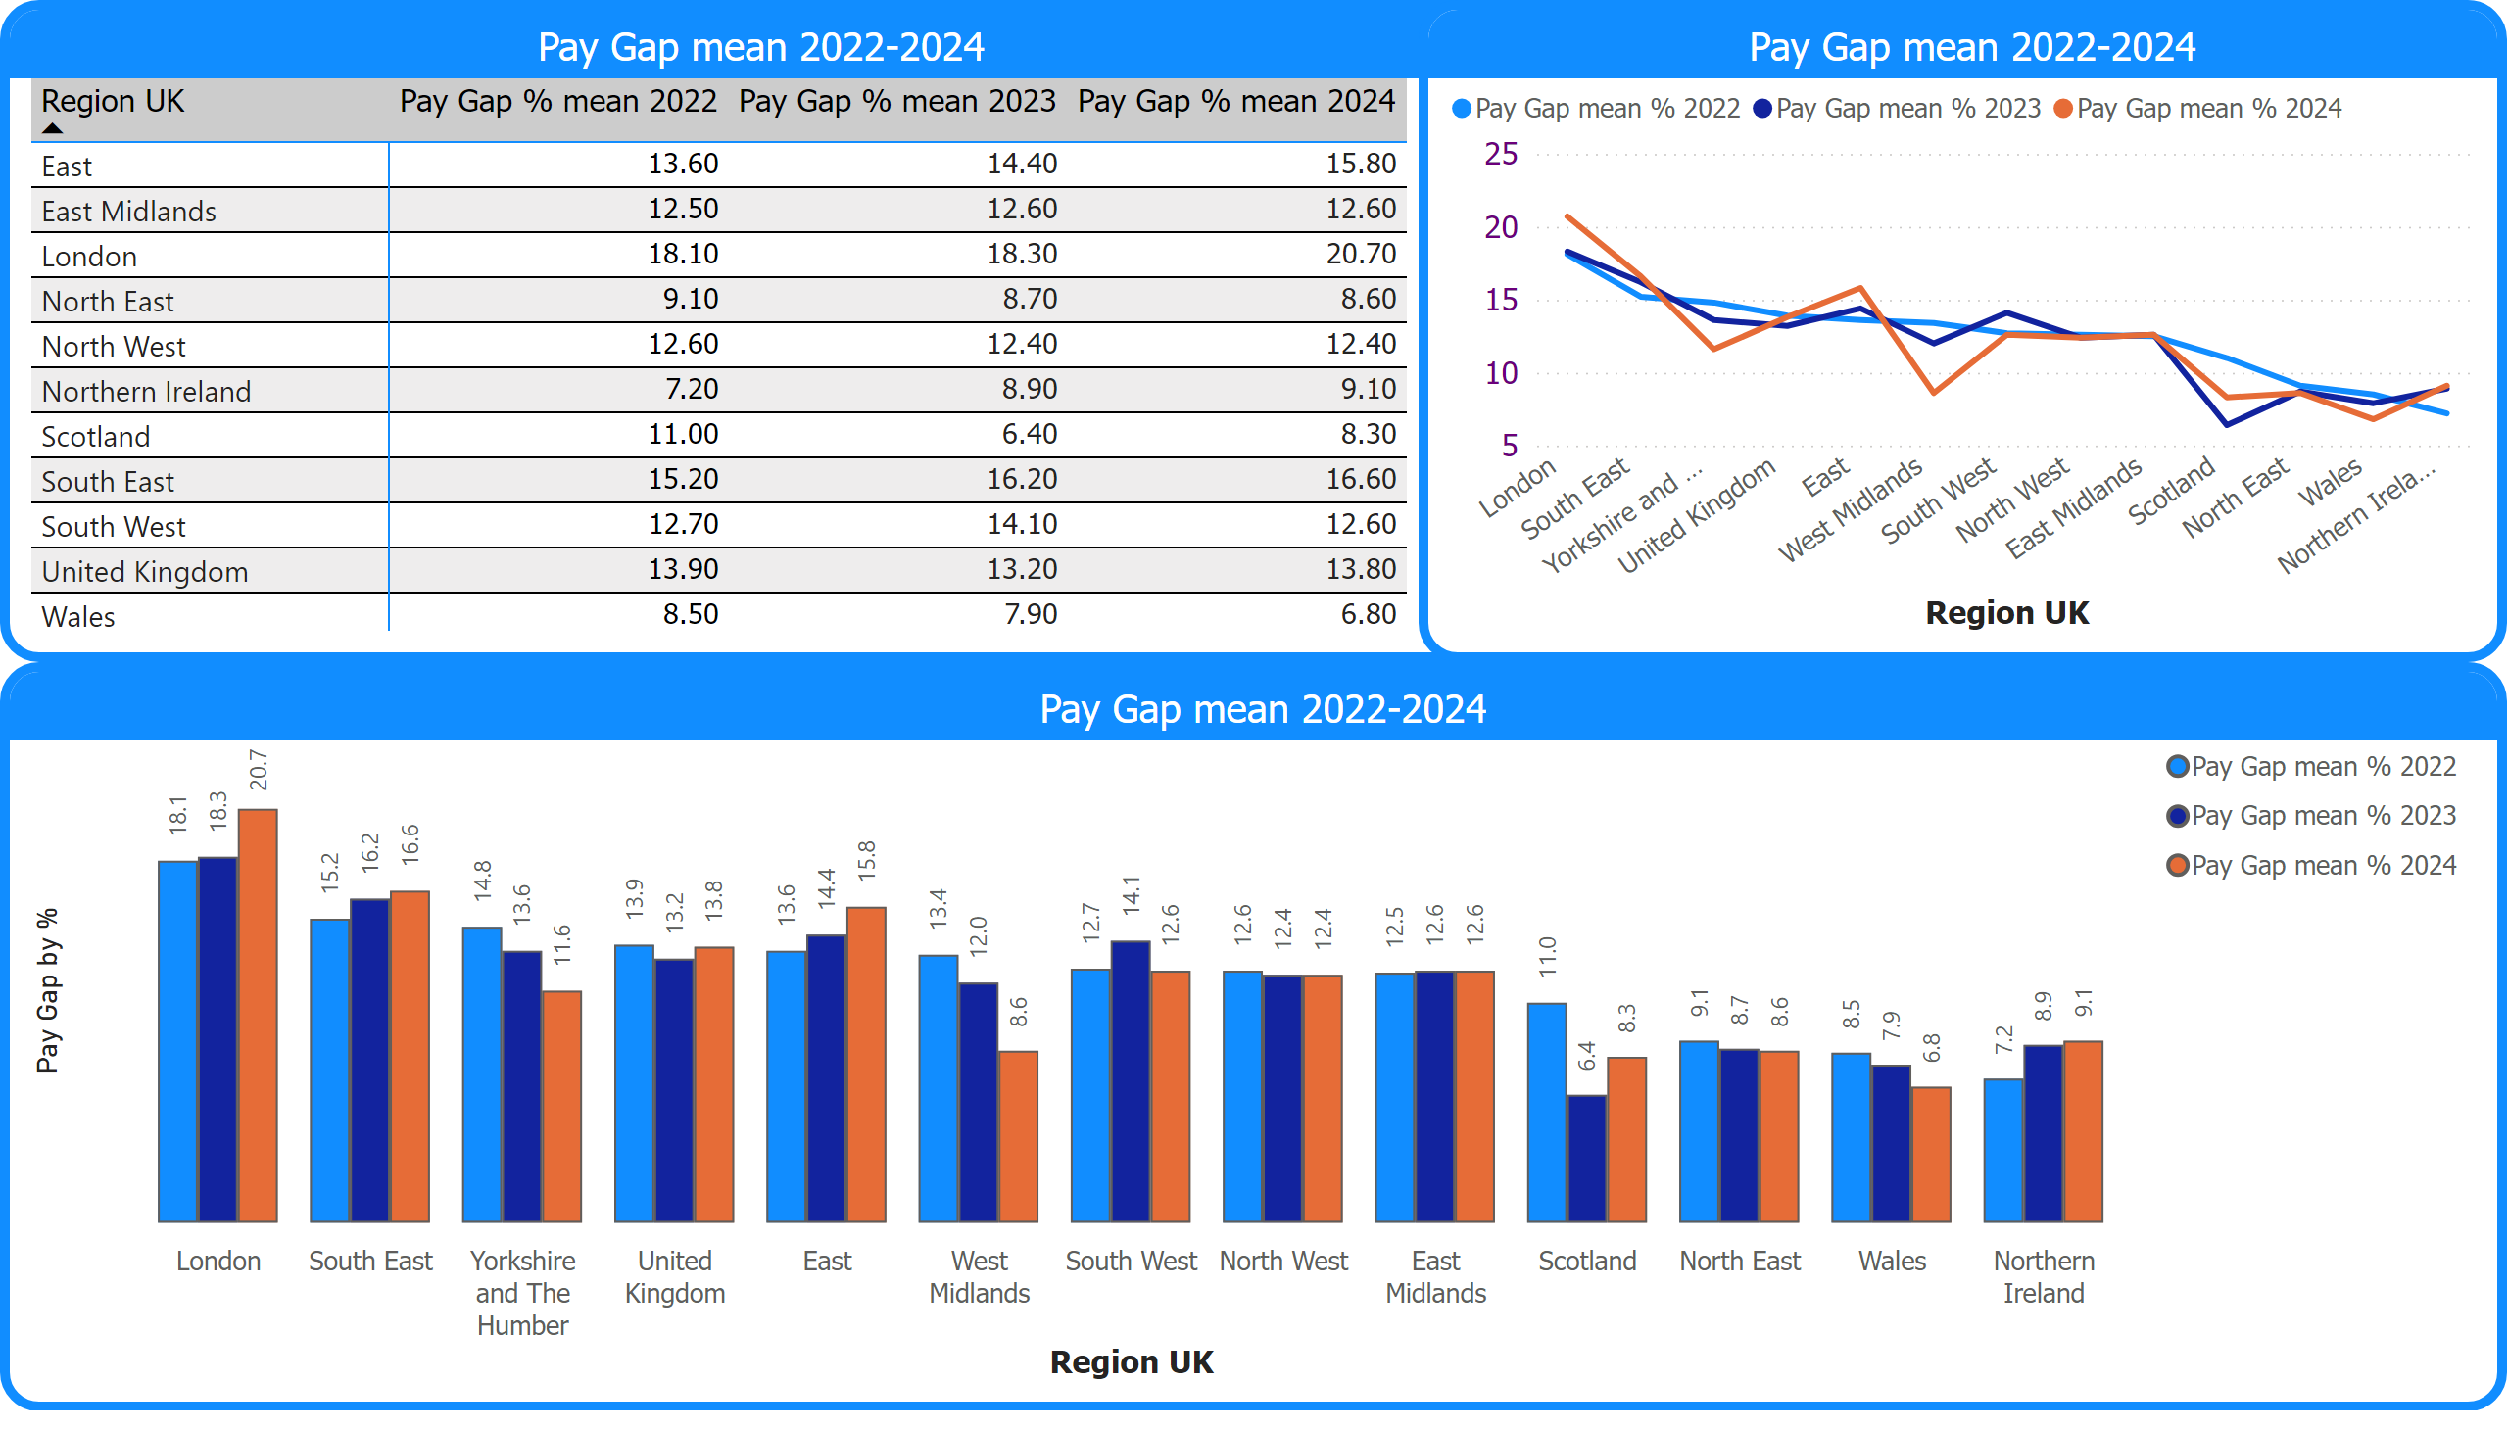
Pay Gap mean 2022-2024
Notes:
Pay Gap mean 2022-2024
No alt text provided
Pay Gap mean 2022-2024
No alt text provided
Pay Gap mean 2022-2024
No alt text provided

Slide 3
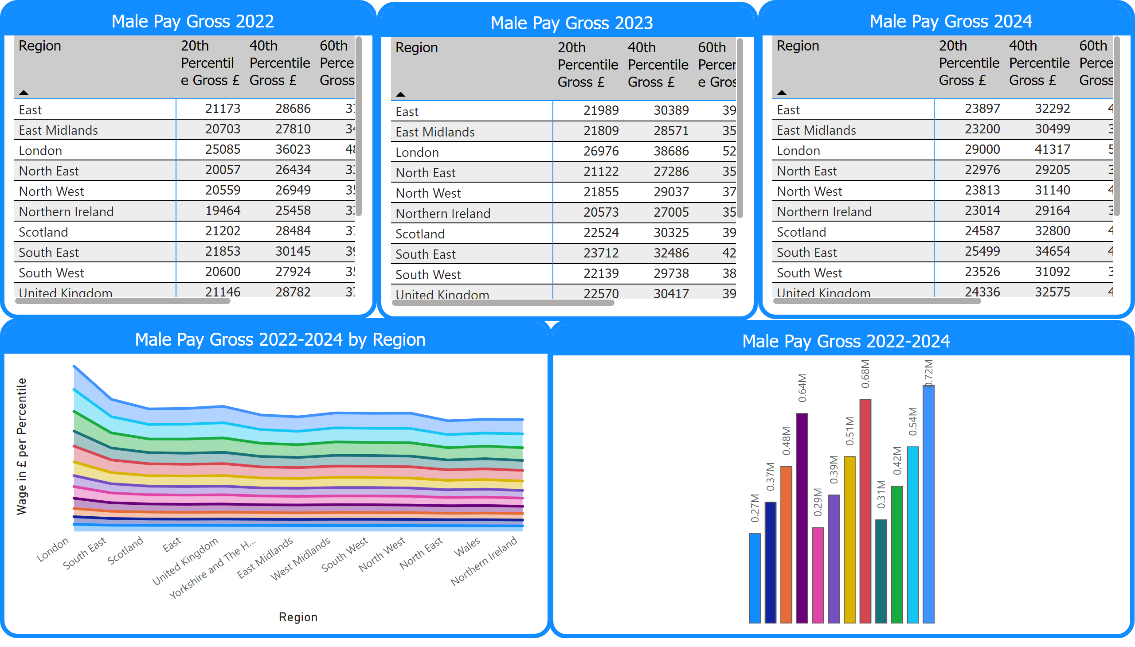
Male Wage by Region 2022-2024
Notes:
Male Pay Gross 2022
No alt text provided
Male Pay Gross 2022-2024 by Region
No alt text provided
Male Pay Gross 2023
No alt text provided
Male Pay Gross 2024
No alt text provided
Male Pay Gross 2022-2024
No alt text provided

Slide 4
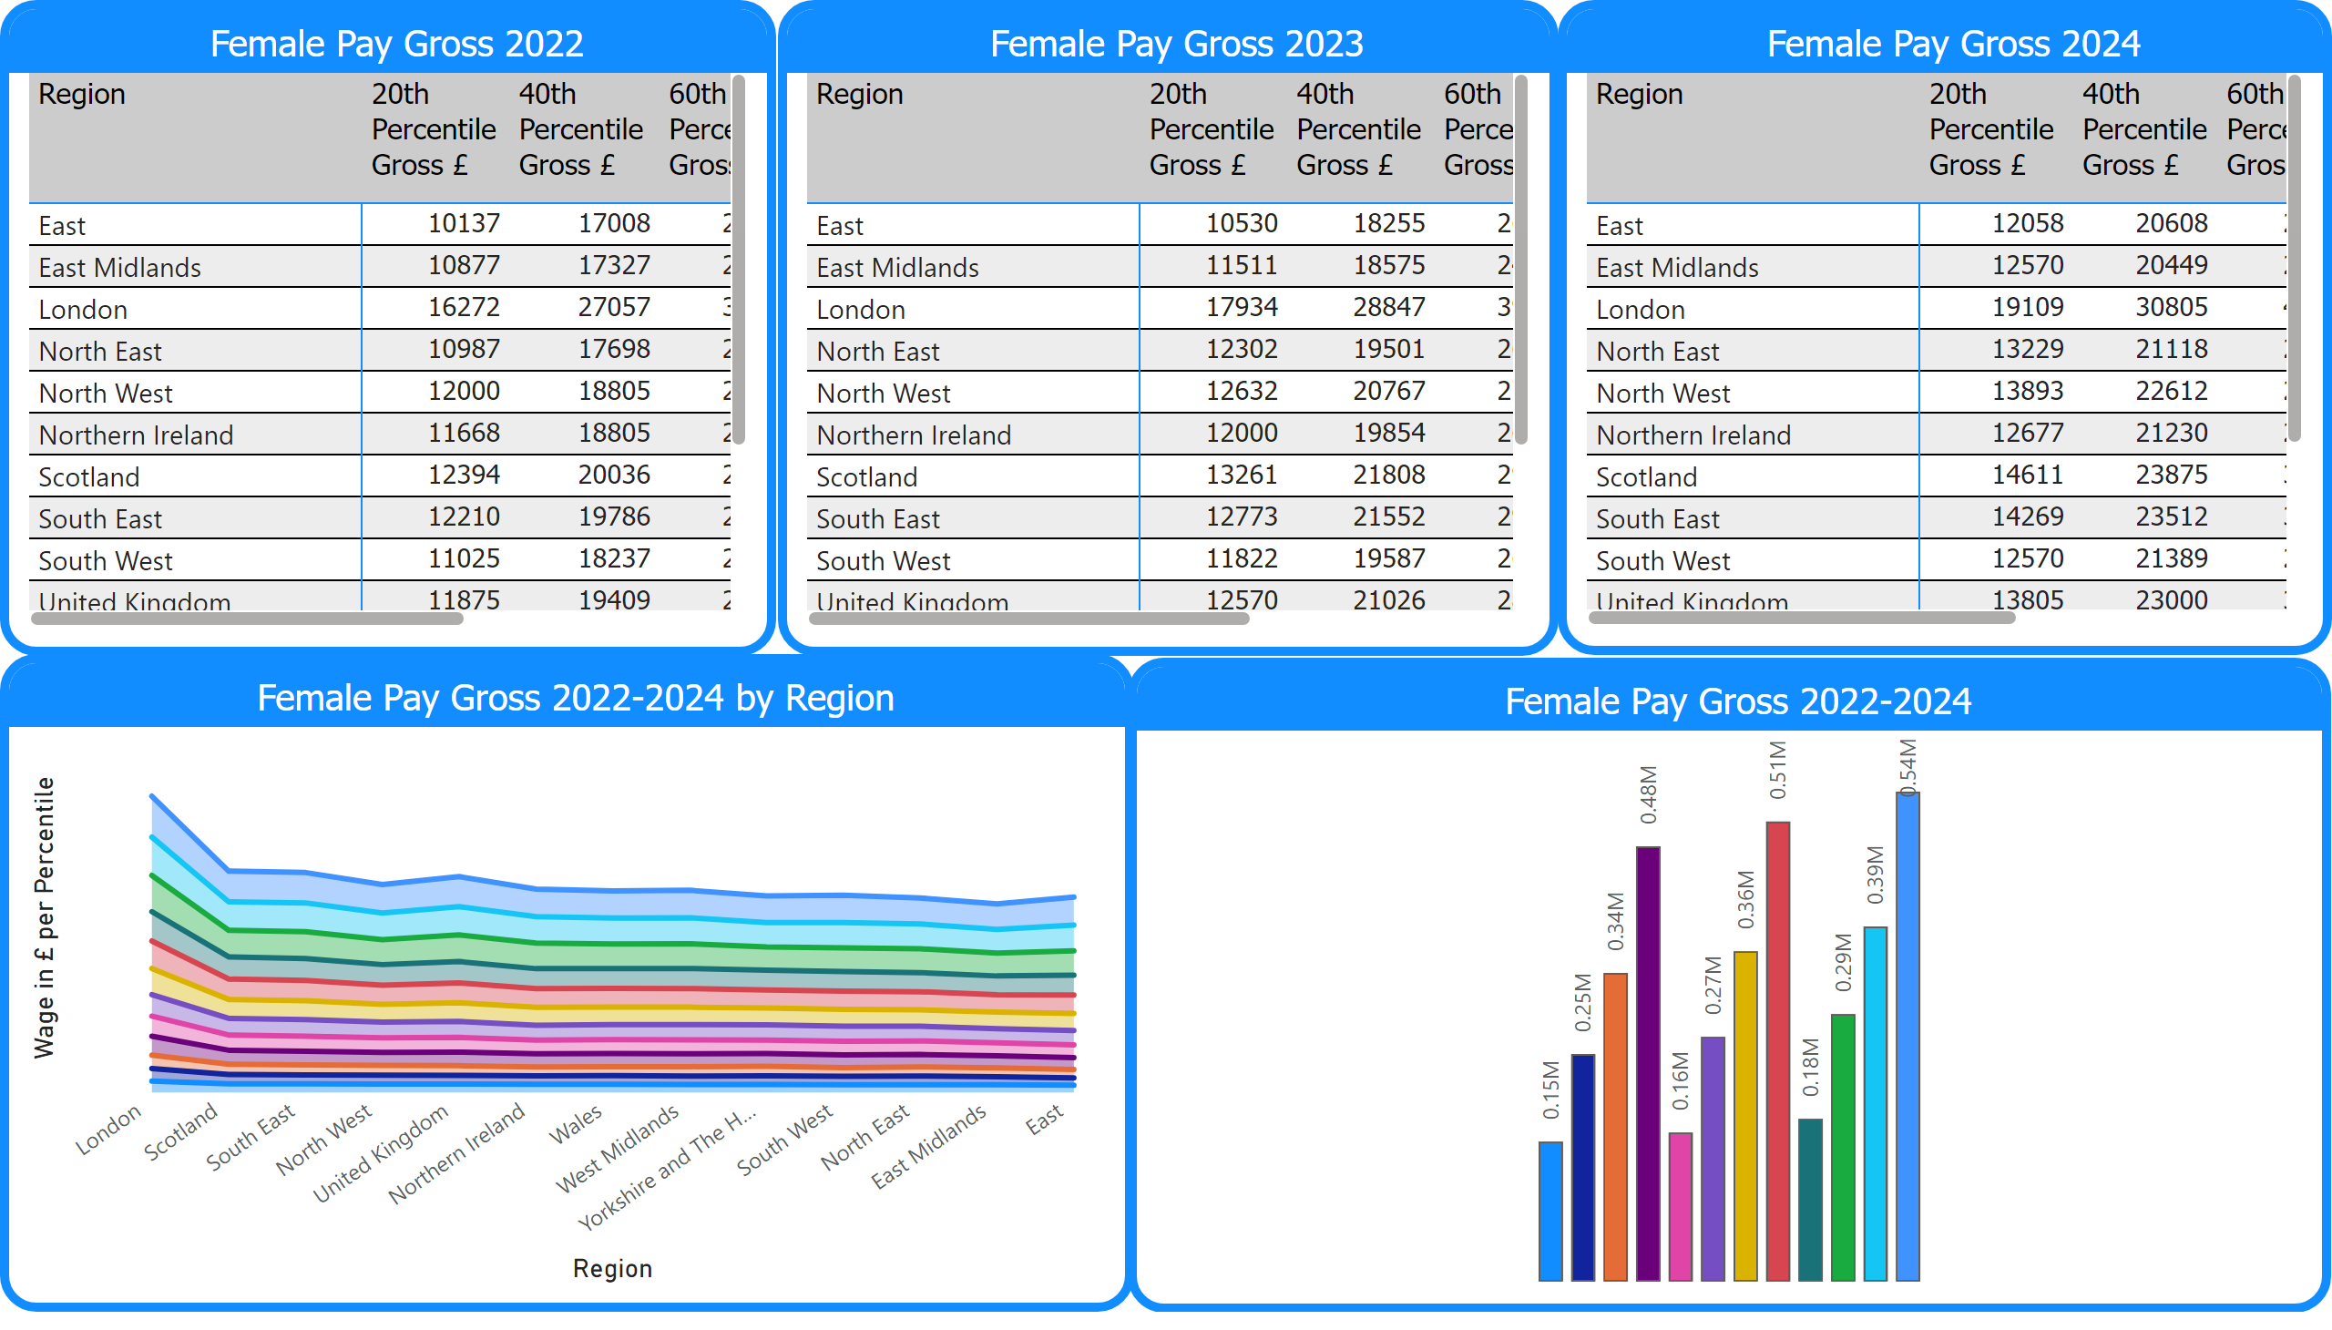
Female Wage by Region 2022-2024
Notes:
Female Pay Gross 2022
No alt text provided
Female Pay Gross 2022-2024 by Region
No alt text provided
Female Pay Gross 2022-2024
No alt text provided
Female Pay Gross 2023
No alt text provided
Female Pay Gross 2024
No alt text provided

Slide 5
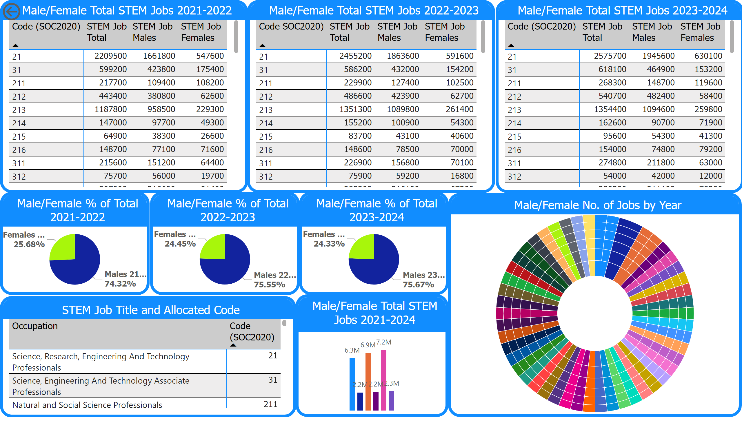
STEM Jobs Male to Female Ratio
Notes:
Male/Female Total STEM Jobs 2021-2022
No alt text provided
STEM Job Title and Allocated Code
No alt text provided
Male/Female % of Total 2021-2022
No alt text provided
Male/Female Total STEM Jobs 2022-2023
No alt text provided
Male/Female Total STEM Jobs 2023-2024
No alt text provided
actionButton
No alt text provided
Male/Female % of Total 2022-2023
No alt text provided
Male/Female % of Total 2023-2024
No alt text provided
Male/Female Total STEM Jobs 2021-2024
No alt text provided
Male/Female No. of Jobs by Year
No alt text provided

Slide 6
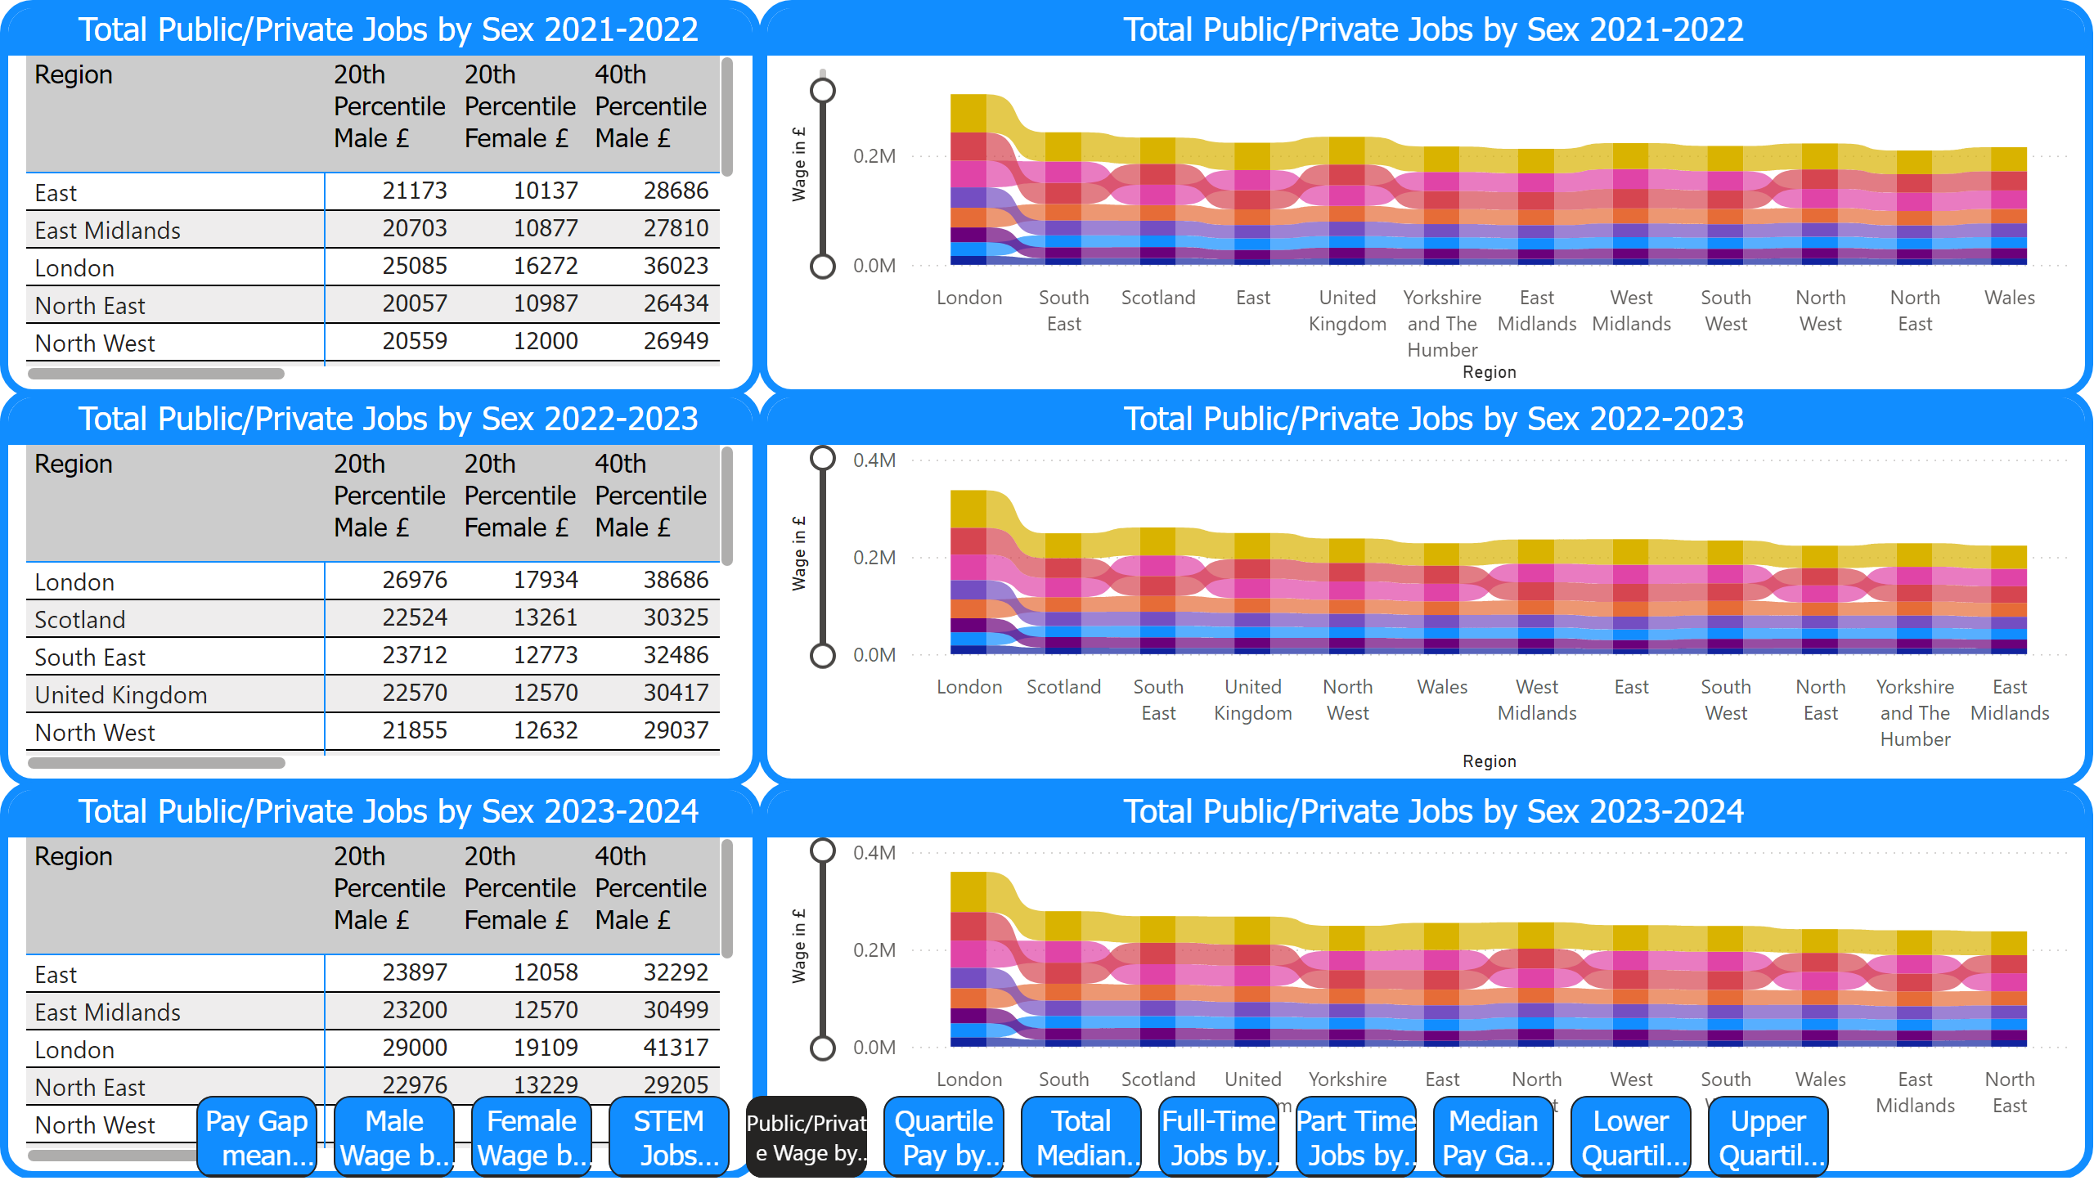
Public/Private Wage by Sex
Notes:
Total Public/Private Jobs by Sex 2021-2022
No alt text provided
Total Public/Private Jobs by Sex 2022-2023
No alt text provided
Total Public/Private Jobs by Sex 2023-2024
No alt text provided
Total Public/Private Jobs by Sex 2022-2023
No alt text provided
Total Public/Private Jobs by Sex 2023-2024
No alt text provided
Total Public/Private Jobs by Sex 2021-2022
No alt text provided
pageNavigator
No alt text provided

Slide 7
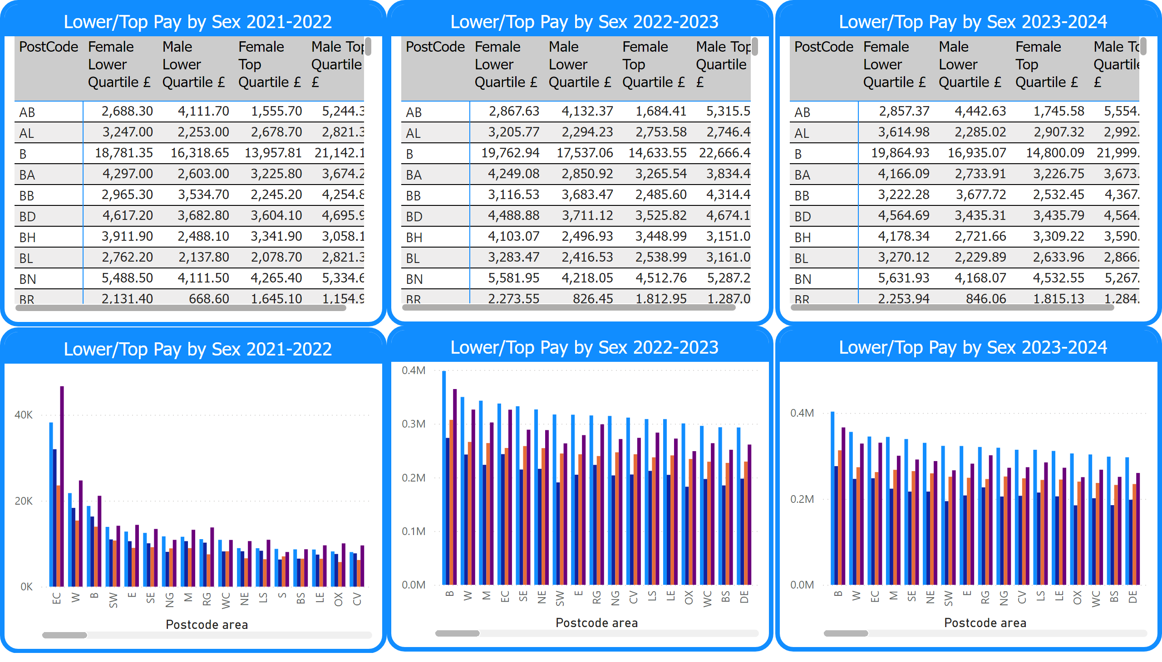
Quartile Pay by Postcode
Notes:
Lower/Top Pay by Sex 2021-2022
No alt text provided
Lower/Top Pay by Sex 2022-2023
No alt text provided
Lower/Top Pay by Sex 2023-2024
No alt text provided
Lower/Top Pay by Sex 2021-2022
No alt text provided
Lower/Top Pay by Sex 2022-2023
No alt text provided
Lower/Top Pay by Sex 2023-2024
No alt text provided

Slide 8
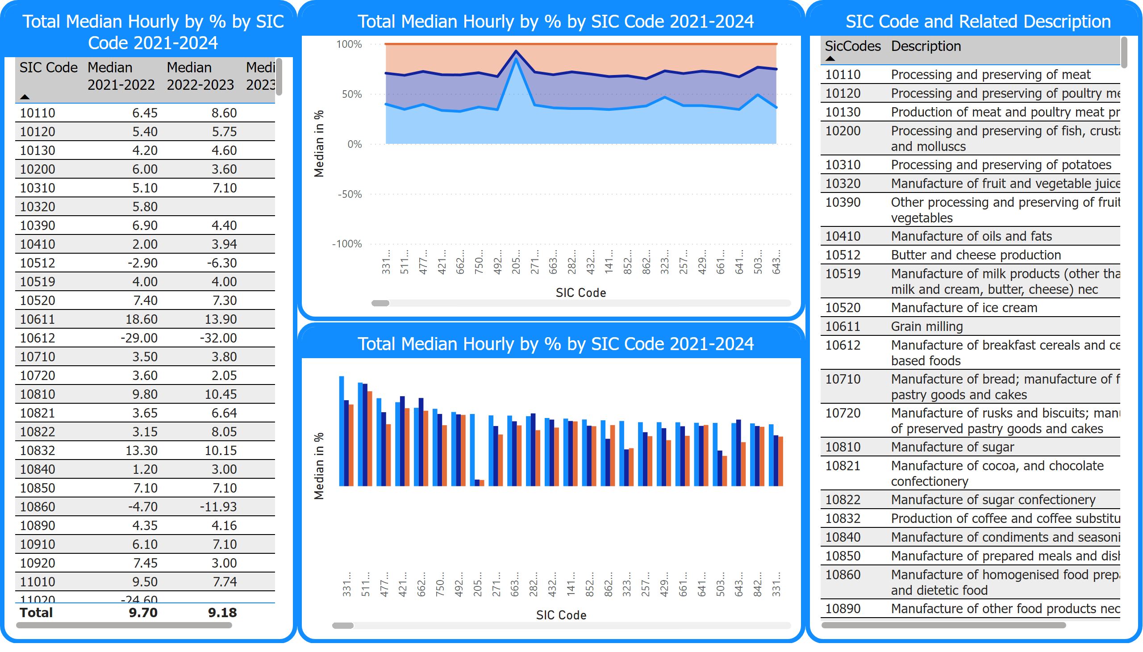
Total Median Hourly in %
Notes:
Total Median Hourly by % by SIC Code 2021-2024
No alt text provided
Total Median Hourly by % by SIC Code 2021-2024
No alt text provided
Total Median Hourly by % by SIC Code 2021-2024
No alt text provided
SIC Code and Related Description
No alt text provided

Slide 9
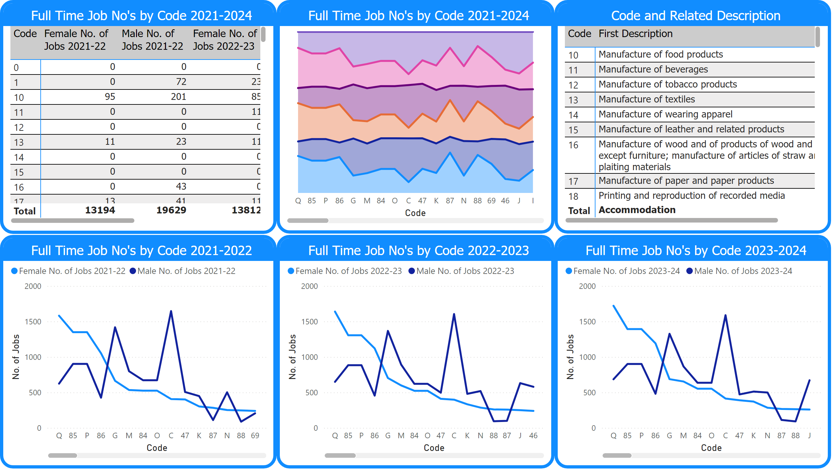
Full-Time Jobs by SIC Code
Notes:
Full Time Job No's by Code 2021-2024
No alt text provided
Full Time Job No's by Code 2021-2024
No alt text provided
Full Time Job No's by Code 2021-2022
No alt text provided
Full Time Job No's by Code 2022-2023
No alt text provided
Full Time Job No's by Code 2023-2024
No alt text provided
Code and Related Description
No alt text provided

Slide 10
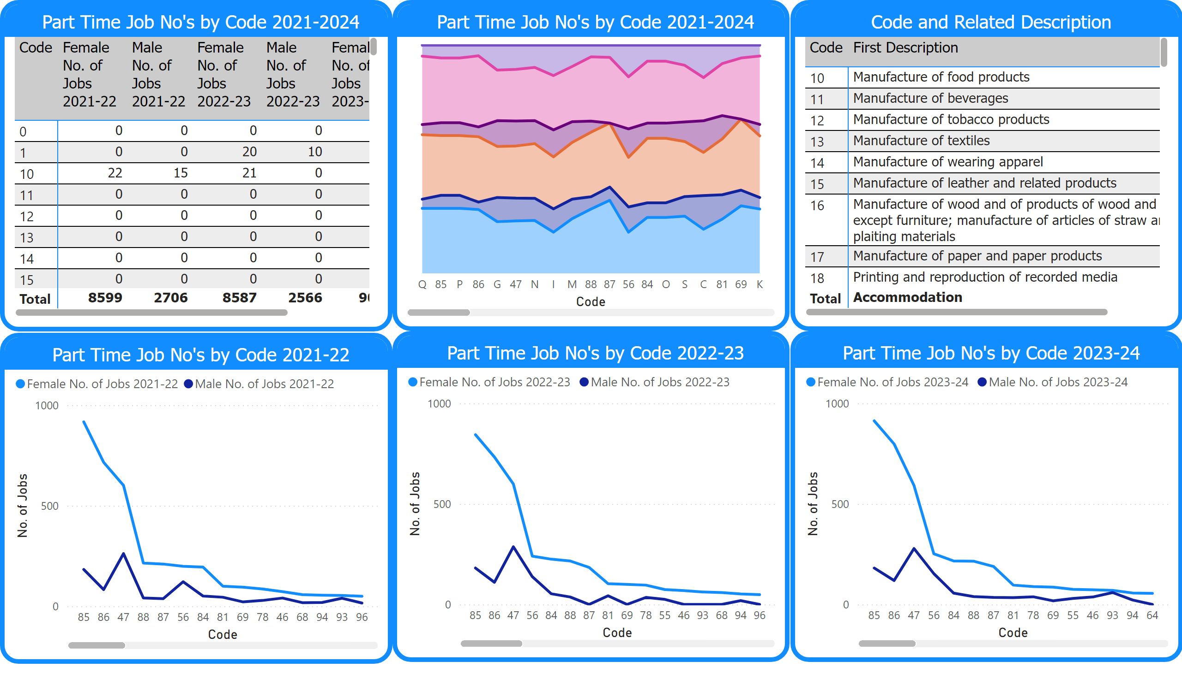
Part Time Jobs by SIC Code
Notes:
Part Time Job No's by Code 2021-2024
No alt text provided
Part Time Job No's by Code 2021-22
No alt text provided
Part Time Job No's by Code 2022-23
No alt text provided
Part Time Job No's by Code 2023-24
No alt text provided
Part Time Job No's by Code 2021-2024
No alt text provided
Code and Related Description
No alt text provided

Slide 11
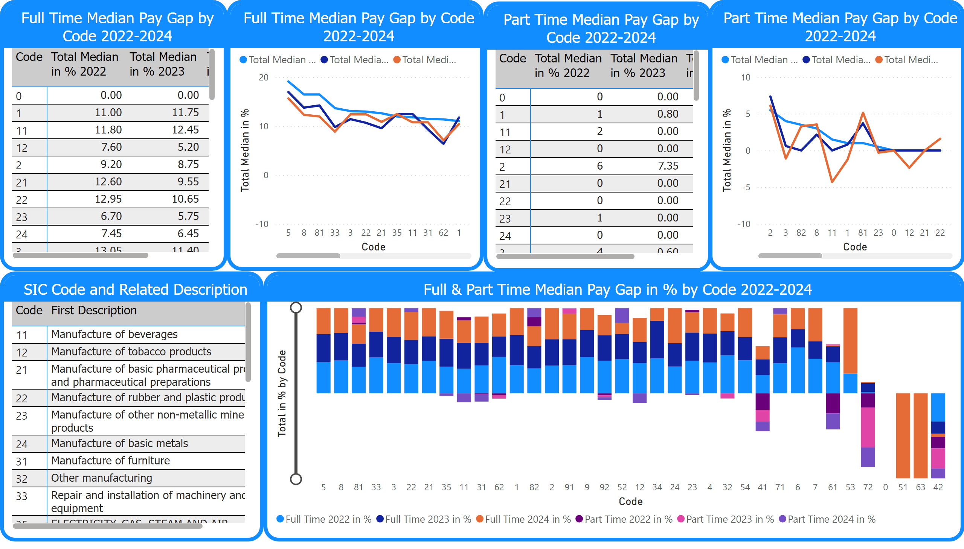
Median Pay Gap by SIC Code Full & Part Time
Notes:
Full Time Median Pay Gap by Code 2022-2024
No alt text provided
Part Time Median Pay Gap by Code 2022-2024
No alt text provided
Full Time Median Pay Gap by Code 2022-2024
No alt text provided
Part Time Median Pay Gap by Code 2022-2024
No alt text provided
SIC Code and Related Description
No alt text provided
Full & Part Time Median Pay Gap in % by Code 2022-2024
No alt text provided

Slide 12
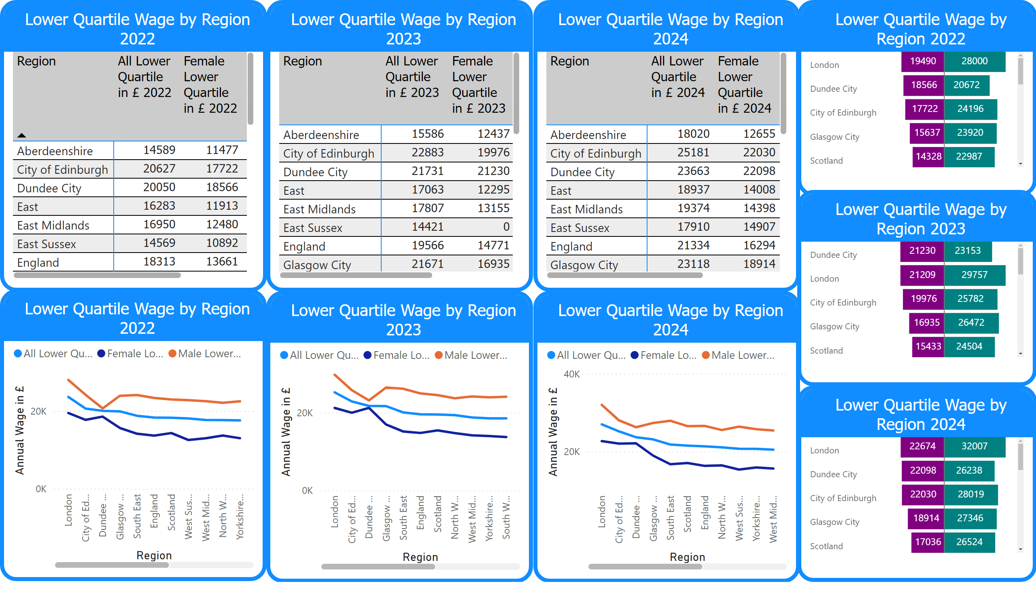
Lower Quartile Wage by Region
Notes:
Lower Quartile Wage by Region 2022
No alt text provided
Lower Quartile Wage by Region 2023
No alt text provided
Lower Quartile Wage by Region 2024
No alt text provided
Lower Quartile Wage by Region 2022
No alt text provided
Lower Quartile Wage by Region 2023
No alt text provided
Lower Quartile Wage by Region 2024
No alt text provided
Lower Quartile Wage by Region 2022
No alt text provided
Lower Quartile Wage by Region 2023
No alt text provided
Lower Quartile Wage by Region 2024
No alt text provided

Slide 13
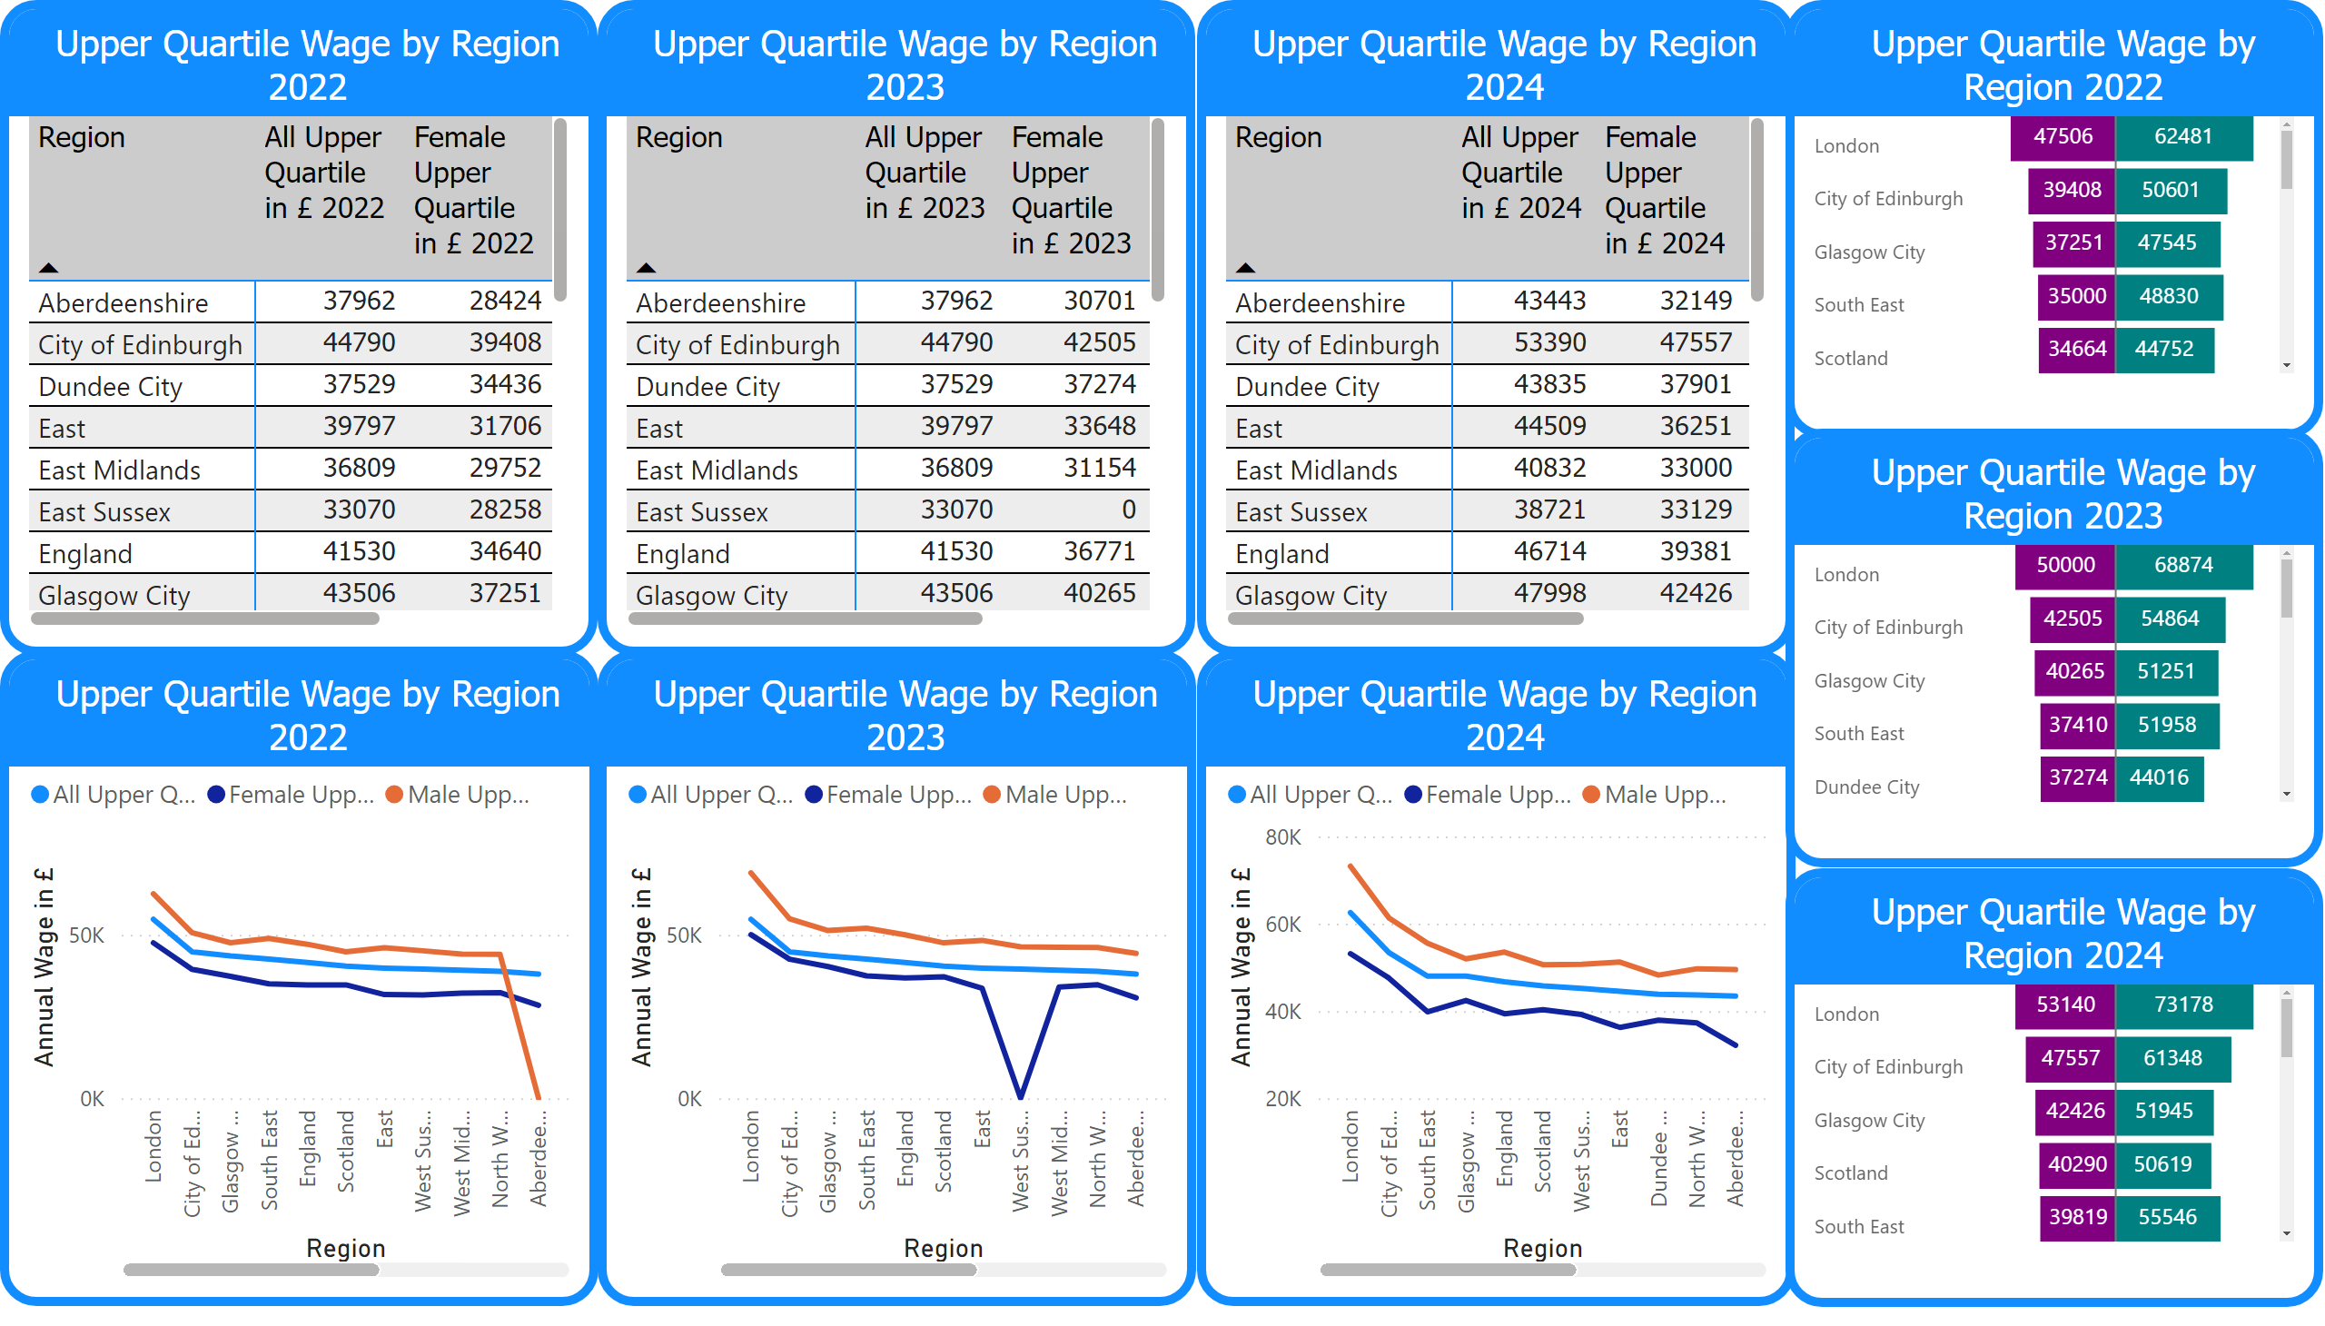
Upper Quartile Wage by Region
Notes:
Upper Quartile Wage by Region 2022
No alt text provided
Upper Quartile Wage by Region 2023
No alt text provided
Upper Quartile Wage by Region 2024
No alt text provided
Upper Quartile Wage by Region 2022
No alt text provided
Upper Quartile Wage by Region 2023
No alt text provided
Upper Quartile Wage by Region 2024
No alt text provided
Upper Quartile Wage by Region 2022
No alt text provided
Upper Quartile Wage by Region 2023
No alt text provided
Upper Quartile Wage by Region 2024
No alt text provided

